Slide 1
Annual Report 2007 Presentation by CEO Frank Gad 27 March 2008

Slide 2
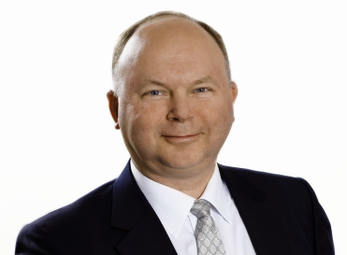
AGENDA
SP Group – an overview
Results 2007
Strategic focus areas
Financial objectives and outlook
Frank Gad (born 1960, M. Sc.)
Career:
Nov. 2004: CEO, SP Group A/S
1999-2004: CEO, FLSmidth A/S
1996-99: President, Mærsk Container Industri A/S
1985-99: Odense Steel Shipyard A/S, most recent title: EVP

Slide 3
SP GROUP – AN OVERVIEW
Manufacturer of moulded plastic components and coatings
Supplier of customer specified solutions for a wide range of industries
Increased exports from Denmark; increased production in China and Poland
Strong international niche positions – also within own brands
Revenue split by the Group’s business units:
171.6
518.5
2007
76.6
117.2
148.7
SP Group A/S
462.0
2006
101.0
INJECTION MOULDING
POLYURETHANE
VACUUM
COATINGS
SP Moulding A/S
Tinby A/S
Gibo Plast A/S
Accoat A/S
121.2
SP Medical A/S
Ergomat A/S
TPI Polytechniek bv
Notes:
SP Group er – kort fortalt – Danmarks største uafhængige producent af emner i formstøbt plast og overfladebelægninger i forskellige materialer, herunder teflon.
Vi er organiseret i 4 forretningsområder:
Sprøjtestøbning er – som det ses af lagkagen øverst til højre - det største område. Dernæst kommer Polyuretan, Vakuumformning og Belægning.
SP Group er underleverandør til en række industrier i det nordlige Europa. Vi er godt i gang med en internationalisering, hvor eksporten fra Danmark øges, og hvor vi samtidig opruster i Kina og Polen for både at betjene de lokale markeder og eksportere herfra.
Vi udvider kort sagt vores markedsdækning og mindsker afhængigheden af det danske marked – men vokser samtidig i Danmark.
Lagkagen nederst viser, hvor langt vi er kommet i en internationalisering. Sidste år hentede vi 37 af hver 100 omsætningskroner uden for Danmark. I 2004 var andelen 31, og året før var den endnu lavere.
Ud over at være underleverandør til industrier i Nordeuropa har SP Group stærke positioner i udvalgte nicher, hvor vi er blandt de største i Europa eller globalt. I nogle af de nicher kontrollerer vi også varemærker og distribution. Det er for eksempel varemærkerne fra vore egne selskaber Ergomat og TPI, som jeg kommer tilbage til.
Og apropos internationaliseringen: Vi har i dag selskaber i 8 lande, hvoraf nogle kom til sidste år. Flere lande er på vej.

Slide 4
HIGHLIGHTS - GROUP
Three out of four business areas reporting growth
Growth primarily created outside Denmark
Overall earnings not at desired level
Impacted by initiatives to improve production facilities and structure of production
Higher raw materials prices
Earnings improving in Polyurethane and Coatings – declining in Injection Moulding and Vacuum
Consolidation of Danish production continues – enhanced efficiency
Building up production capacity in China and Poland
Revenue DKKm
+5.4%
Operating profit (EBITDA) DKKm
-0.7%

Slide 5
GROUP HIGHLIGHTS 2007
DKKm | 2007 | 2006
Revenue | 869.7 | 825.4
EBITDA | 72.9 | 73.4
EBIT | 34.6 | 36.0
Profit before tax and minorities | 21.2 | 20.6
Net profit | 15.9 | 12.9
Equity incl. minorities | 179.0 | 167.1
Cash flows from:
Operations | 53.6 | 37.5
Investments | -52.2 | -67.5
Financing | 9.7 | 38.6
Profit before tax
and minorities, DKKm
Earnings per share, DKK

Slide 6
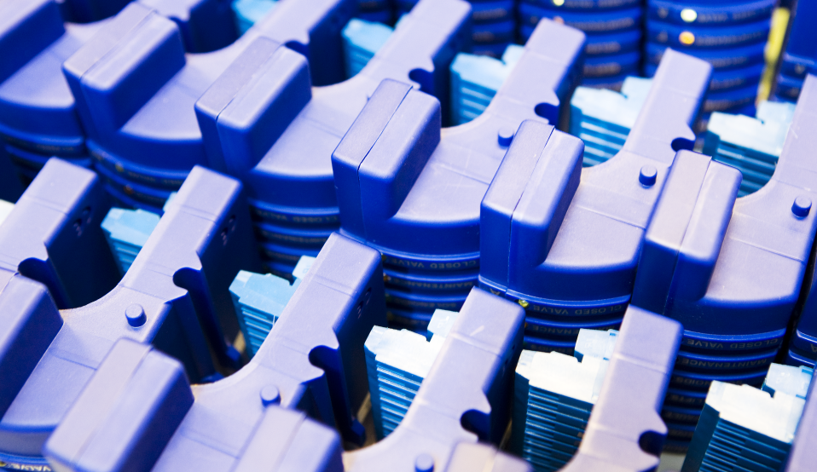
Business areas

Slide 7
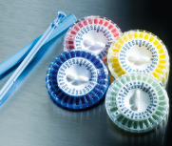
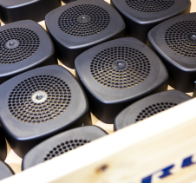
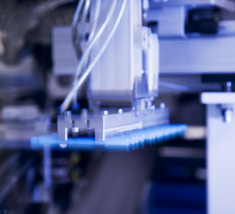
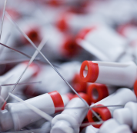
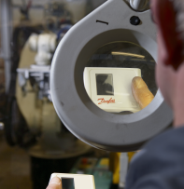
INJECTION MOULDING (1)
SP Moulding A/S manufactures injection moulded advanced plastic components for a wide range of industries.
SP Medical A/S produces for customers in the medical appliance industry, including finished articles such as medical guide-wires. The production takes place in clean rooms.
SP Moulding is the leading injection moulding company in Denmark and among the largest in Scandinavia. SP Medical ranks 3-4 in Scandinavia.
Locations: Juelsminde (DK), Stoholm (DK), Karise (DK), Sieradz (POL) and Suzhou (China)
Medico
Technical
plastics
Medico
Medico
2K and 3K moulding

Slide 8
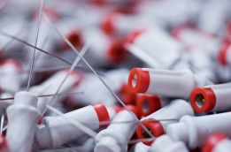
INJECTION MOULDING (2)
2007:
12.2% growth - 1.3% organic growth
Continuing operations had a reasonable year – overall results not satisfactory
Record earnings by SP Medical
Production in China was profitable
Poland profitable from Q4 2007
Closure of Sønderborg plant more costly than anticipated – all costs recognised in 2007
DKKm | 2007 |  | 2006
Revenue |  | 518.5 | 462.0
EBITDA |  | 22.8 | 27.2
EBIT |  | -2.3 | 9.0
Total assets |  | 340.8 | 313.1
Employees (average) |  | 599 | 494
Outlook for 2008:
Revenue set to drop relative to 2007
Loss of two customers anticipated – including licence plates
Increased revenue from new customers
Strong growth in SP Medical
Earnings set to improve sharply

Slide 9
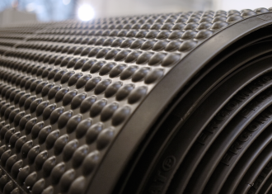
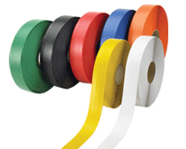
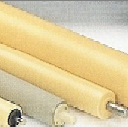
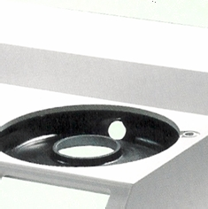
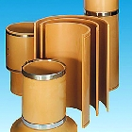
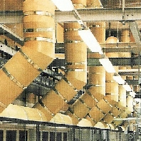
POLYURETHANE (1)
Three business activities: Ergomat A/S, Tinby A/S and TPI Polytechniek BV
Locations: Søndersø (DK), Zdunska Wola (POL), ’s-Hertogenbosch (NL), Helsingborg (SE), Cleveland (US), Montreal (CAN) and Zeil am Main (DE)
Ergomat develops, manufactures and sells ergonomic solutions under own brands: Ergomat® mats, ErgoPerfect® chairs, Synchron® tables and DuraStripe™ striping tape for corporate customers worldwide. Market leader in the EU.
Mats
DuraStripe
Tinby manufactures moulded products in solid, foamed and flexible PUR for the graphics, medical appliance, furniture, refrigerator, wind turbine and insulation industries. Global market leader within hard rollers.
Rollers
Solid foamed
PUR
TPI Polytechniek develops and sells concepts for ventilation of industrial buildings as well as poultry and pig pens, primarily products under the brands of ReaDan and TPI. Market leader in the EU.

Slide 10
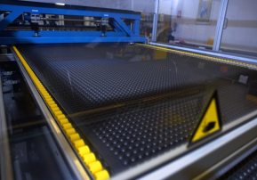
POLYURETHANE (2)
2007:
15.4% organic growth
Ergomat: Modest growth (4%) – due to concern resulting from the US financial crisis and the weaker USD
Tinby: High growth rate in Tinby (26%) e.g. within the wind turbine industry
TPI: Sales increased by 14%, particularly strong performance by Eastern Europe
EBIT and EBIT margin higher due to better product mix and growing activities
DKKm | 2007 | 2006
Revenue | 171.6 | 148.7
EBITDA | 34.5 | 30.4
EBIT | 27.1 | 23.3
Total assets | 174.3 | 158.6
Employees (average) | 218 | 193
Outlook for 2008:
Higher revenue and improved earnings overall
Growth in TPI may be effected by the very low meat prices and high feed prices

Slide 11
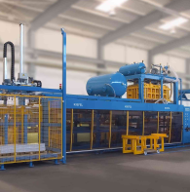
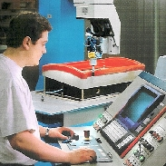
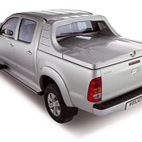
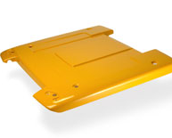
VACUUM FORMING (1)
Gibo Plast develops, designs and manufactures thermoformed plastic products. The products are mainly used in refrigerators and freezers, buses and cars (automotive), medical devices and lighting equipment as well as in wind turbines.
Gibo Plast has specialises in traditional vacuum forming and the new High-pressure and Twinsheet technologies.
Market leader in Scandinavia.
Locations: Skjern (DK) and Spentrup (DK)
Vacuum forming
CNC milling
Automotive
Automotive

Slide 12
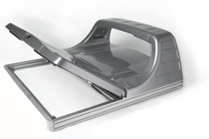
VACUUM FORMING (2)
2007:
The work on the strategic challenges resulted in the acquisition of DKI Form at the beginning of 2008
Much stronger market position
Considerable synergies
Access to new customers
Opportunity to provide highly complex solutions
Revenue fell by 24%
Greater-than-expected drop in sales to the refrigerator and freezer industry
DKKm | 2007 | 2006
Revenue | 76.6 | 101.0
EBITDA | -0.6 | 8.4
EBIT | -3.3 | 5.3
Total assets | 81.5 | 88.6
Employees (average) | 66 | 76
Outlook for 2008:
Revenue expected to nearly double
Earnings set to improve

Slide 13
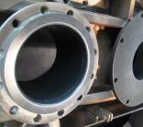
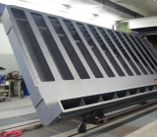
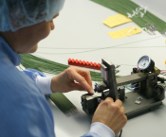
COATINGS (1)
Accoat develops and applies non-stick, low-friction and high-build corrosion protection coatings in Teflon, PTFE and other refined materials for a wide range of industries. Accoat engages in coating of both industrial products and production equipment. Products coated range from very small needles to large tank facilities.
Within industrial teflon coating Accoat is among the five largest suppliers in the EU.
Location: Kvistgård (DK)
Coating
Coating
Medico

Slide 14
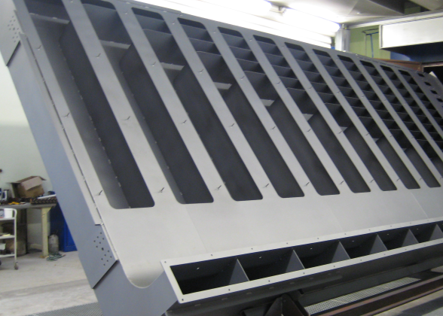
COATINGS (2)
2007:
Organic growth of 19% - adjusted for transfer of Accoat Medical to SP Medical
Increased activity with very large items
High growth in industries such as chemical, medical devices and oil/gas
Stronger margins due to better mix, higher capacity utilization and relocation of activities
Trial production of nano-coating
DKKm | 2007 | 2006
Revenue | 117.2 | 121.2
EBITDA | 22.2 | 17.8
EBIT | 18.4 | 11.5
Total assets | 95.0 | 118.2
Employees (average) | 64 | 121
Outlook for 2008:
Increased revenue and slightly higher earnings

Slide 15
CREATING VALUE FOR THE SHAREHOLDERS
Share price performance, 2 January to 31 December 2007
Index 2.1.2006 = 110
SP Group
12% return in 2007
43% return in 2006
29% return in 2005
All-share index
Kurs
Omsætning
2.1.2006
2.4.2006
2.7.2006
2.10.2006
2.1.2007
2.4.2007
2.7.2007
2.10.2007
31.12.2007
Source: OMX Copenhagen and Danske Markets
Share capital DKK 200m
All shares have equal rights
Major shareholders’ ownership
6.0%
28.5%
Major shareholders
Others
2005
94.0%
53.6%
2006
46.6%
2007
71.5%

Slide 16
Strategy

Slide 17
INCREASED SALES AND INTERNALISATION
Strengthen sales and marketing efforts in all units
Focus on both existing and new customers
Differentiation on processes, design and knowledge of raw material
Increased exports from production sites in Denmark, China and Poland
International sales in DKKm
International sales in %
Organic growth in % (group revenue)
+8.8%
+1.3pp
-10.1pp

Slide 18
GROWTH INDUSTRIES AND OWN BRANDS
Stronger engagement in growth industries and new segments, e.g. medico and wind mills
Medico sales account for more than one-fifth of Group revenue
Competencies gathered in SP Medical with FDA-certified production in Denmark and Poland
Globalization of products under own brands (TPI, Guide-wires and Ergomat)
Potential in other product niches to be leveraged
New niche products with control of brands and distribution
Medico revenue in DKKm
+9.2%
Revenue from own brands in DKKm
+11.4%

Slide 19
RATIONALISATION OF DANISH PRODUCTION
Sites closed since 2004
Existing sites:
Skjern
Kvistgaard
Søndersø
Karise
Juelsminde
Stoholm
6
1
2
5
3
4

Slide 20
EXPANSION IN POLAND AND CHINA
New PUR factory in Poland to be built during 2008
Need for a 100% expansion of capacity due to expected growth
Polish injection moulding factory making money from last quarter of 2007
Polish medical devices factory making money in H2-2007
Continuing expansion of capacity at SP Moulding in China
SP Group set to follow customer relocation
Sites in Poland
Zdunska Wola
Sieradz
Poland
2
1

Slide 21
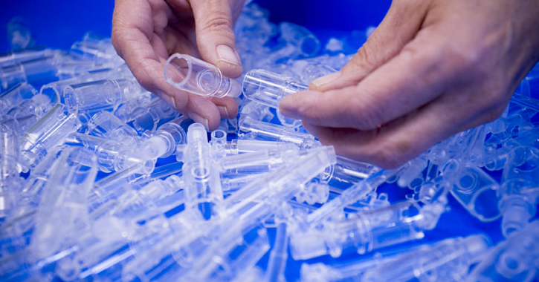
Financial objectives and outlook

Slide 22
LONG-TERM FINANCIAL OBJECTIVES
Profit before tax and minorities of approx. DKK 100m in 2012 – 6-7% of revenue. DKK 50m i 2009
Group revenue of around DKK 1.5bn in 2012. DKK 1.0bn i 2009
EBITDA margin to exceed 10%
Increase cash flows from operations
NIBD/EBITDA ratio of between 3 and 4 in 2009
11.5 in 2004; 4.6 in 2007
Equity ratio (incl. equity of minorities) in the range of 20-35%
Competitive return to shareholders from rising share price
Revenue in DKKm
+72%
Profit before tax
and minorities in DKKm
376%

Slide 23
OUTLOOK FOR 2008
 |  | Outlook for 2008 | 2007
Revenue | Growth of 3-7% = DKK 895-930m |  | DKK 869.7m
EBITDA | Approx. DKK 90m (approx. 10%) |  | DKK 72.9m (8.4%)
EBIT | Approx. DKK 50m |  | DKK 34.6m (4,0%)
Profit before tax and minorities | Approx. DKK 30m |  | DKK 21.2m
Growth expected in three business units, shortfall of revenue in Injection moulding (including from loss of licence plate business)
EBT growth expected in all four business
Outlook assumes that current operations, raw materials and energy prices, exchange rates and economic conditions will remain at current levels

Slide 24
FORWARD-LOOKING STATEMENTS
This presentation reflects management’s expectations for future events and financial results.
The statements as regards 2008 and the following years are subject to uncertainty and actual results may therefore deviate materially from the outlook and the financial objectives.
Circumstances that could cause changes include, but are not limited to, changes in raw materials and energy prices, changes in exchange rates, changes in the macroeconomic and political settings, changes in customer demand and production patterns and other external factors.
This presentation is not an invitation to buy or sell shares in SP Group A/S.
Notes:
Der er – som allerede nævnt – helt normale usikkerheder knyttet til de forventninger, vi lægger frem: Råvarepriser, valutakurser og fugleinfluenza, blandt andet. Derfor dette sædvanlige forbehold for fremadrettede udsagn.
KLIK

Slide 25
TAK FOR I DAG
THANK YOU FOR YOUR ATTENTION
For more information: Frank Gad, CEO SP Group A/S 6-10 Snavevej DK-5471 Søndersø Phone: (+45) 7023 2379 / (+45) 3042 1460 E-mail: fg@sp-group.dk www.sp-group.dk

